Slide 1
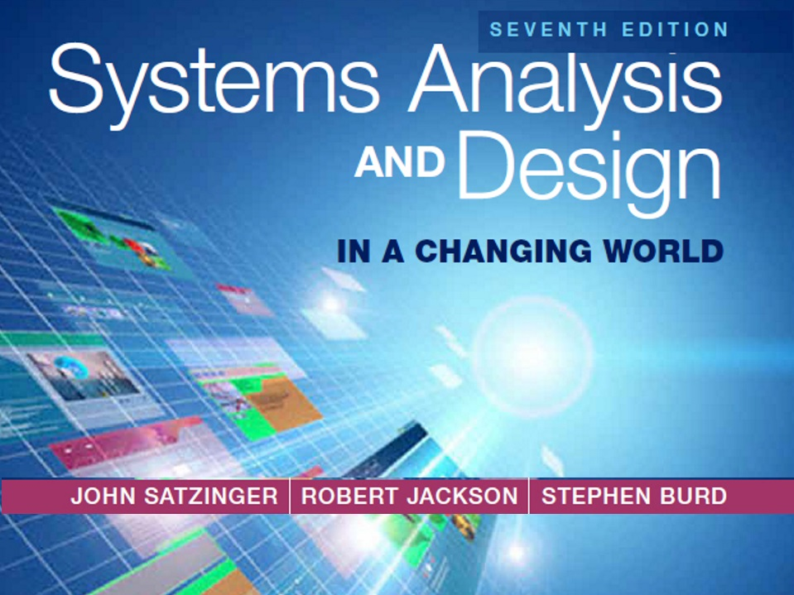
Chapter 9

Slide 2
Designing the Database
Chapter 9
Systems Analysis and Design in a Changing World 7th Ed
Satzinger, Jackson & Burd

Slide 3
Distributed Database Architectures
Decentralized database is stored at many locations but not requiring interconnectivity or synchronization
Homogeneous distributed database is stored at multiple locations, with all locations using the same DBMS. Coordinated with a global schema
Heterogeneous distribute database is stored at multiple locations and with different DBMS and may have local schemas.

Slide 4
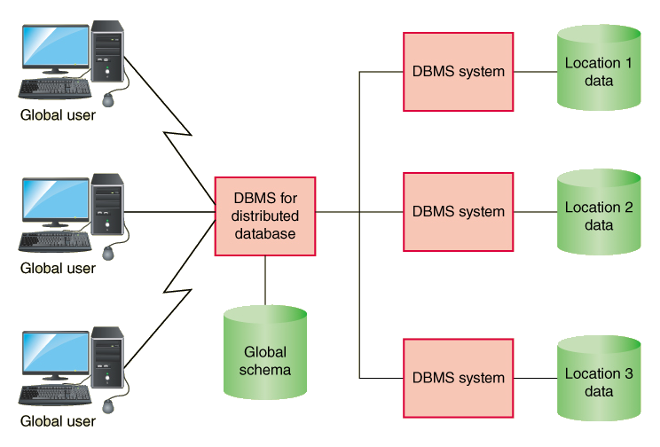
Homogeneous Distributed Database
Access is through a common DBMS and schema

Slide 5
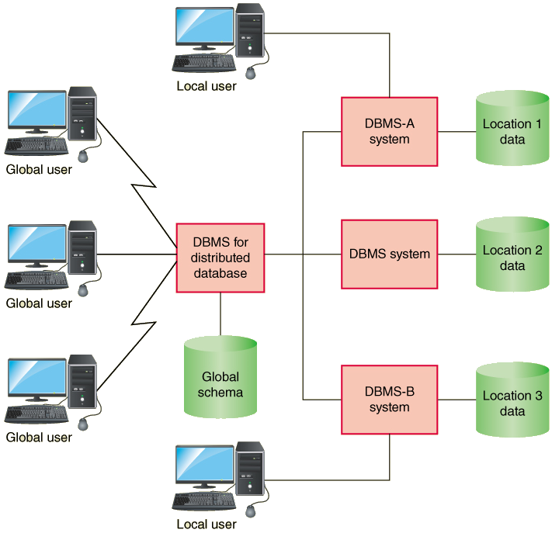
Heterogeneous Distributed Database
Access is through distinct DBMSs. May have global and local schemas in operation

Slide 6
Implementation Approaches
Data replication – each location has its own copy
Synchronization – updating every copy with changes made to every other copy

Slide 7
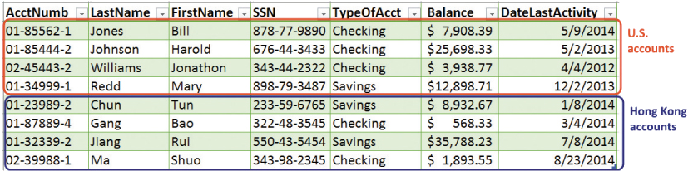
Implementation Approaches
Horizontal Partition – different rows are stored at different locations.

Slide 8
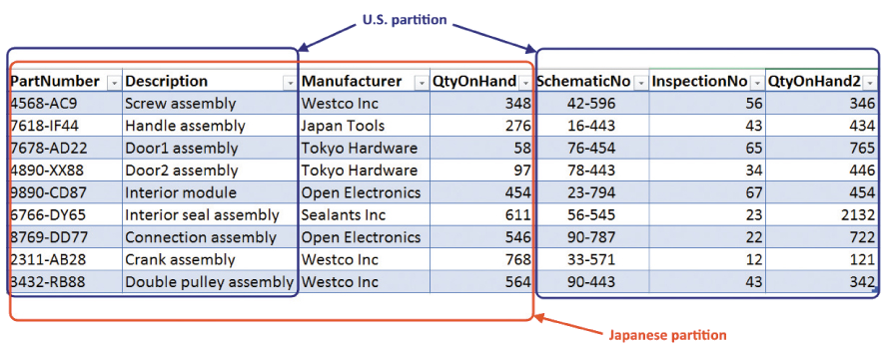
Implementation Approaches
Vertical Partition – Different columns are stored at different locations.
Combinations of replication, horizontal, and vertical

Slide 9
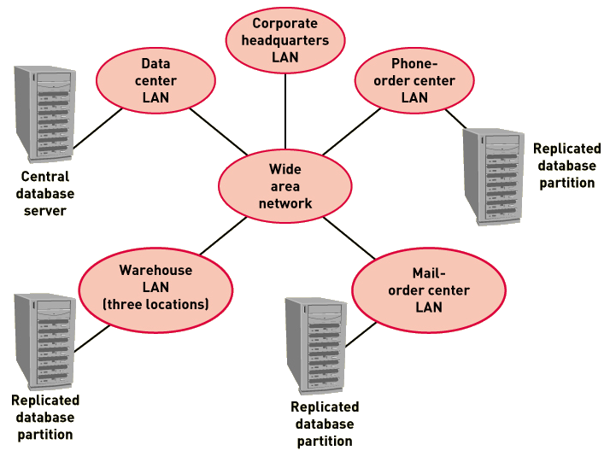
Architecture for RMO Replicated and Partitioned Database

Slide 10
Protecting the Database
Transaction Logging – a technique to record all updates including change, date, time, user
Helps to prevent fraud
Recovery mechanism for failures

Slide 11
Protecting the Database
Concurrency and Update Controls
Transaction – a piece of work with several steps, either all must complete or none must be accepted
Database lock – technique to apply exclusive control to a portion of the database to one user at a time
Shared or read lock – a lock where multiple transactions (users) may read the data
Exclusive or write lock – a lock where only one transaction (user) may access the locked portion of the database

